Slide 1
GEARS QUEST
Where quality meets performance

Slide 2
Group members
Supervisor
M. Tahir Imtiaz
Syed Faseeh Sajid Rizvi
Hannan Butt
Mr Fawad

Slide 3
AGENDA
Introduction
Problem Statement
Literature Review/Background
Current Solutions
Factors Considered
Project Scope
Project Modules
Features
Architecture Diagram
Modules vs. Features
Requirements
Design Phase

Slide 4
INTRODUCTION
Aiming to introduce a dedicated online platform to meet evolving needs.
Focused on innovation and efficiency in the online marketplace.
Creating a seamless and secure online environment for transactions.
Implementing separate panels for administrators, sellers, and buyers.
Striving for a significant positive impact on overall user experience.
Aiming to enhance and modernize spare parts transactions in the market.

Slide 5
PROBLEM
The current automotive spare parts market in Pakistan lacks a dedicated online platform focused on facilitating transactions for second-hand spare parts.
Buyers face challenges in accessing a wide range of second-hand spare parts, limiting their choices and opportunities to find suitable products.
The current market's lack of a dedicated platform contributes to a transparency deficit, making it difficult for users to make informed decisions about their purchases.

Slide 6
literature review and background
The automotive spare parts market in Pakistan has experienced significant growth in recent years, driven by the expansion of the automotive industry.
Existing solutions often lack dedicated platforms tailored to the unique needs of the automotive spare parts market.
The project specifically focuses on addressing the gap in the market for second-hand spare parts, recognizing the demand and potential growth in this segment.
The literature review underscores the need for a platform that fosters transparency, enhances user experience, and streamlines the process of buying and selling second-hand spare parts.

Slide 7
current solutions
The automotive spare parts market in Pakistan currently lacks a centralized and dedicated online platform, resulting in a fragmented market presence.
Existing e-commerce platforms provide spare parts as a subset, lacking specialized features essential for the automotive spare parts industry.
Buyers and sellers often face inefficiencies in transactions, including limited product information, inadequate search functionalities, and cumbersome order processing.
The review and rating systems on general e-commerce platforms do not cater specifically to the automotive spare parts market, impacting the credibility of product and seller reviews.
The current solutions often prioritize new spare parts, neglecting the growing demand and potential of the second-hand spare parts market.

Slide 8
Factors considered
User-Friendly Interface
Transparency and Trust
Efficient Order Processing
Comprehensive Search and Filter
Empowering Sellers
Administrator Oversight
Security Measures
Specialization in Second-Hand Market
Feedback Mechanism

Slide 9
SCOPE
Development and implementation of an online marketplace
Dedicated to second-hand spare parts for cars and bikes
Focus on providing a user-friendly and transparent environment
Facilitating secure transactions and efficient order processing
Introduction of distinct panels for administrators, sellers, and buyers
Key features include user authentication, buyer and seller dashboards, product listings, cart management, and order tracking
Emphasis on advanced search and filter functionalities
Robust seller dashboard for effective inventory management
Administrator panel for oversight and management
Integration of a feedback mechanism for user trust and satisfaction
Contribution to the growth of the automotive and e-commerce sectors in Pakistan

Slide 10
MODULES
Admin module
spare parts listing module
User Management Module
Order Management module

Slide 11
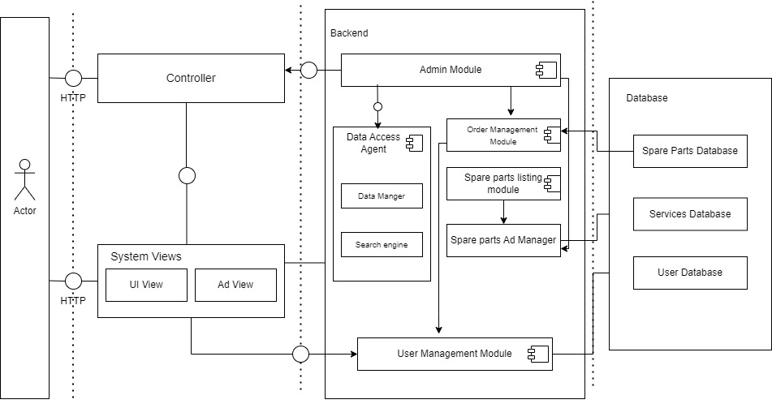
Architecture diagram

Slide 12
FEATURES
User Registration and Login
Product Listings
Shopping Cart
Wish-list
Checkout
Order History
Order Tracking
Search and Filter
Account Information
Dashboard (Buyer, Seller, Admin)
Add Product Form
Product Listing Details

Slide 13
FEATURES
Order Management
Seller Authentication
Admin Dashboard
Manage Orders
Manage Listings
User Management
Feedback (Reviews and Ratings)
Seller Gallery
Customer Reviews and Seller Ratings
Product Review and Rating
Chat Support
Product Management (Edit, Update, Remove)

Slide 14
WORK DONE IN FYP-1
Authentication
Buyer Home Page
Cart
Checkout
Search and filter
Seller Dashboard
Add product form
Product Listing
Seller authentication
Admin dashboard
Manage orders
Manage listing

Slide 15
ROADMAP FOR FYP 2
Wish-list
Order history
Order tracking
Account Information
Payment Integration
Product review and ratings
Seller Gallery
Customer Reviews and Seller Ratings
Chat support
Product category

Slide 16
Hardware requirements
Standard desktop or laptop computers for accessing the platform.
Optional: Android and IOS devices for users who prefer mobile access.

Slide 17
Software requirement
Support for modern web technologies.
Examples include Google Chrome, Mozilla Firefox, Safari, and Microsoft Edge.
Compatibility with standard operating systems.
Integration with third-party payment processors.
User manuals for effective navigation.
Assumption: Users have access to a stable internet connection.

Slide 18
Functional requirements
User Management
Product Listings and Search
Shopping Cart and Checkout
Order Management
Review and Rating System

Slide 19
Non-functional requirements
Usability:
The platform must be user-friendly and accessible.
Portability:
The platform should be designed for scalability and maintainability.

Slide 20
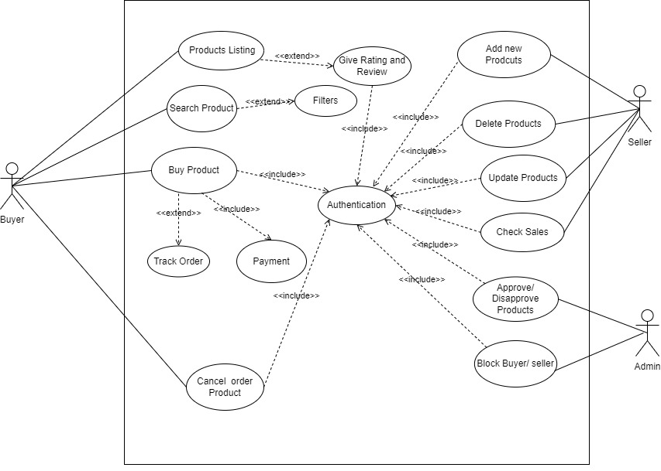
Use-case diagram
The Gear Quest platform facilitates secure and authenticated transactions, offering buyers advanced search and filtering options, order tracking, and cancellation features, while empowering sellers with product management tools, sales monitoring, and ensuring administrative control with approval/disapproval and user management functionalities.

Slide 21
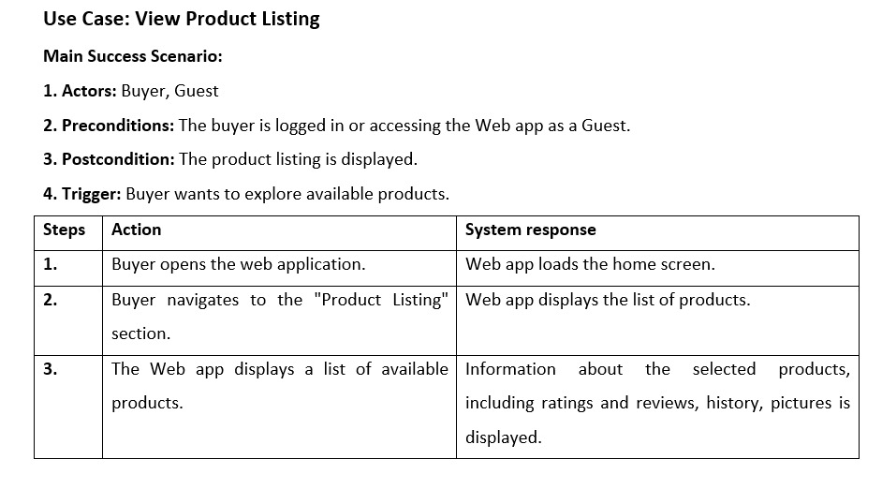
Fully dress usecase

Slide 22
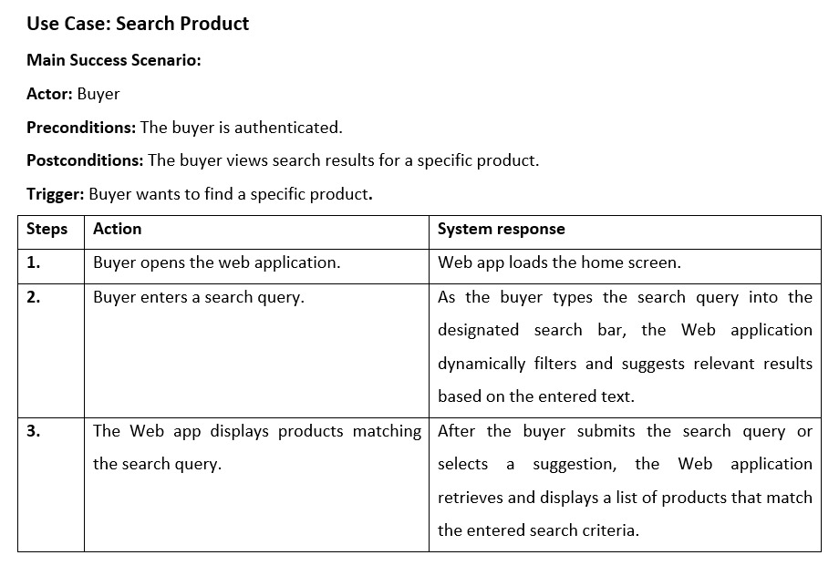
Fully dress usecase

Slide 23
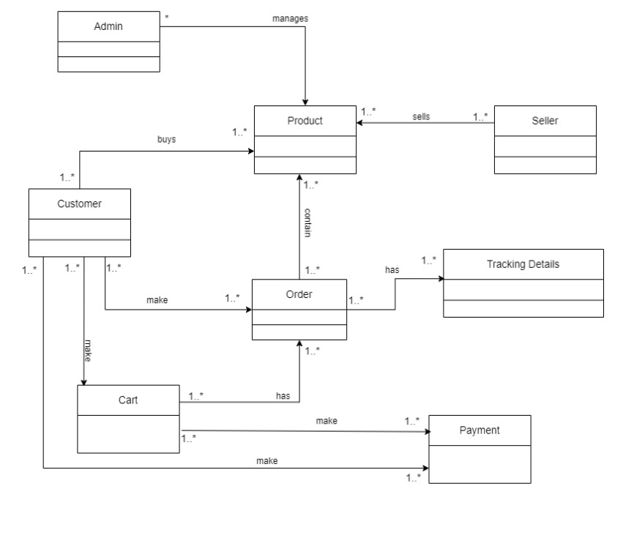
Domain model

Slide 24
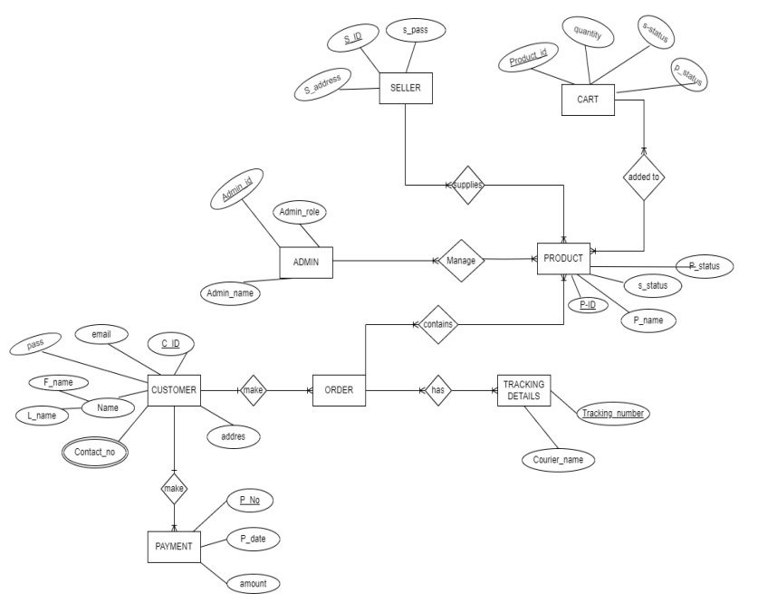
Er - diagram

Slide 25
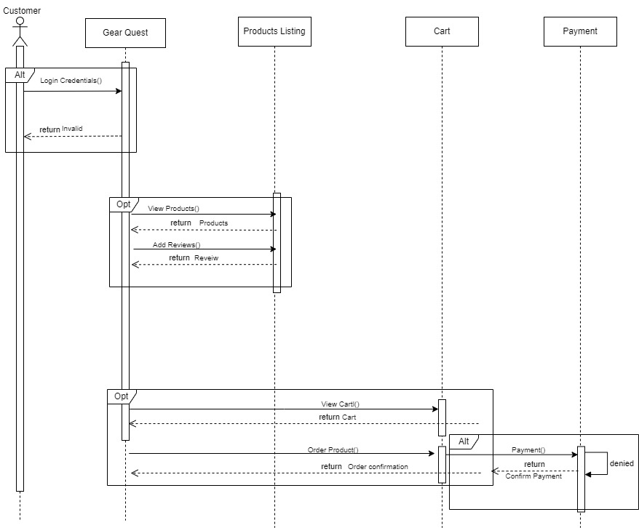
Sequence diagram
CUSTOMER:

Slide 26
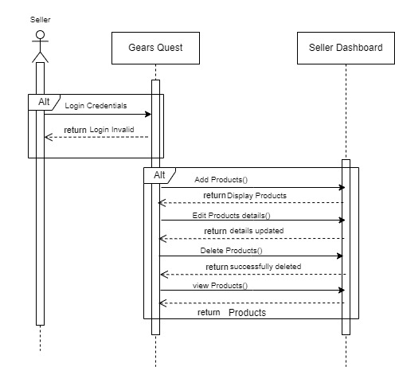
Sequence diagram
Seller;

Slide 27
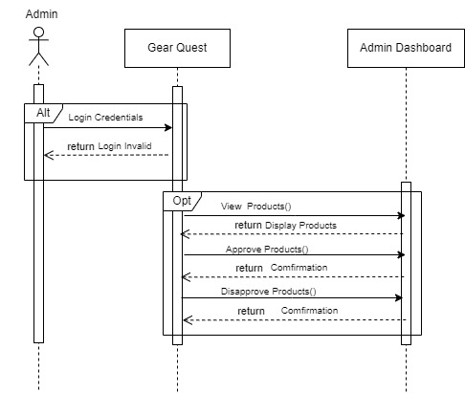
Sequence diagram
Admin:

Slide 28
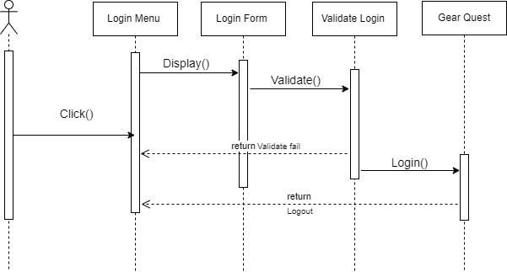
Sequence diagram
Registration:

Slide 29
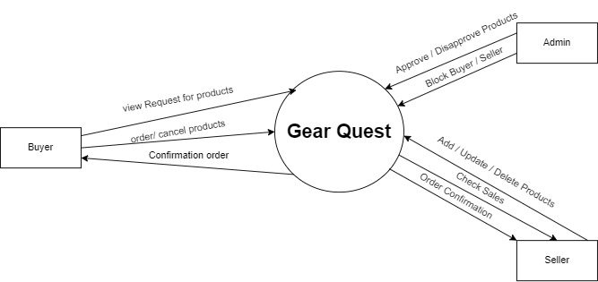
Dfd – level 0

Slide 30
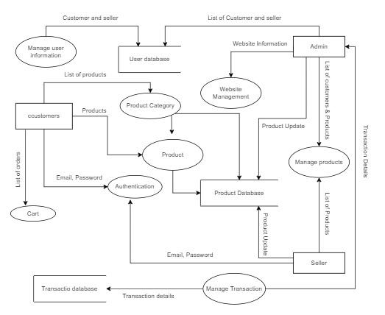
Dfd – level 1

